Slide 1
Test Plan
[B-SORT-2] Sort High to Low Vs Low to High April 27, 2020
Prepared by Adobe Consulting April 2020

Slide 2
Contents
Overview
Design
Specifications
Results

Slide 3
1. Overview

Slide 4
Overview [B-SORT-2] Sort High to Low Vs Low to High
DEVICES All Device Types
LOCATION PackersProShop.com: Product Category Pages
METRICS Primary: Conversion Rate
Secondary: Revenue per Visitor, Average Order Value, Clicks to Sort By (prop20), Product Views, Cart Additions & Checkouts
AUDIENCES All Visitors
REVENUE N/A
HYPOTHESIS
Changing the default sorting method on product category pages will help determine whether sorting by high to low versus low to high pricing is more effective than the default ”Recommended” sorting method.
BUSINESS OBJECTIVE
Drive conversion rate by optimizing the default sorting method on product category pages.

Slide 5
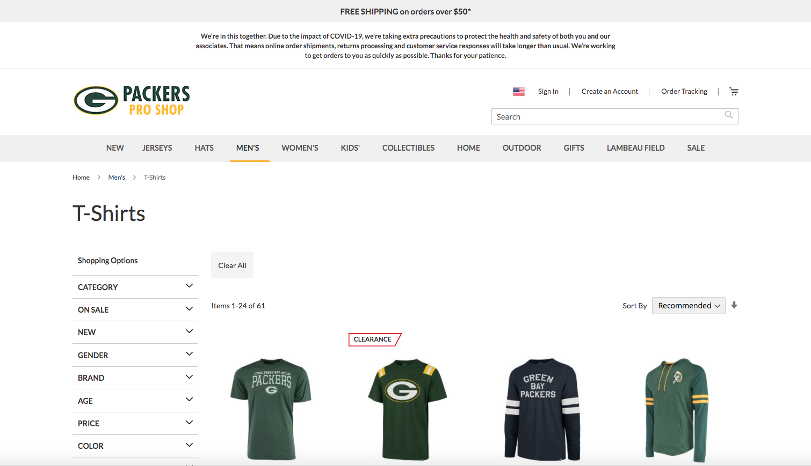
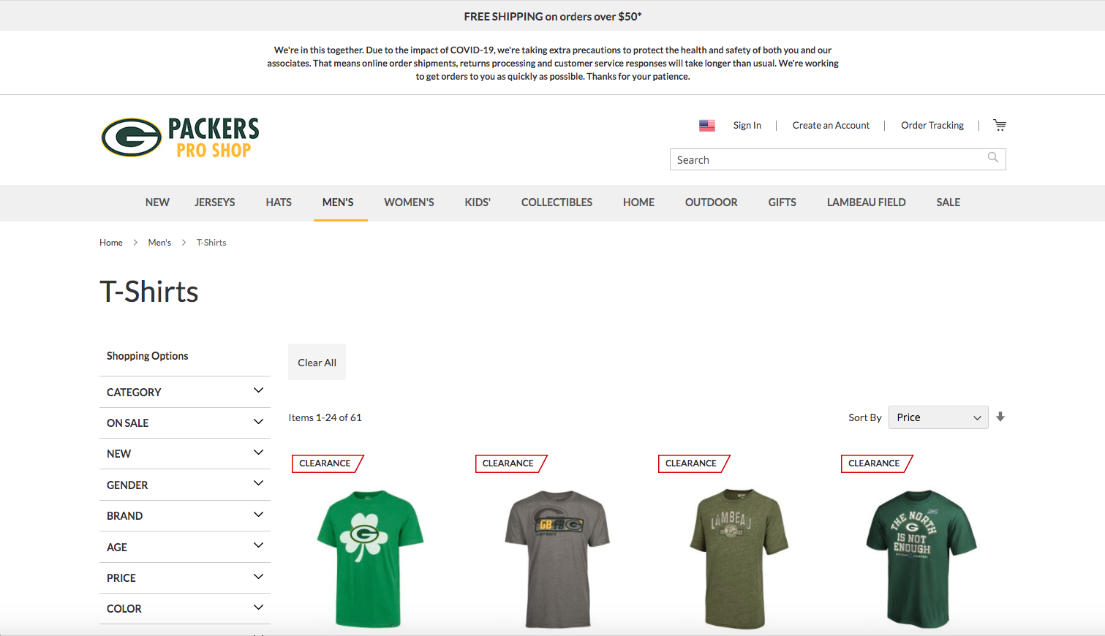
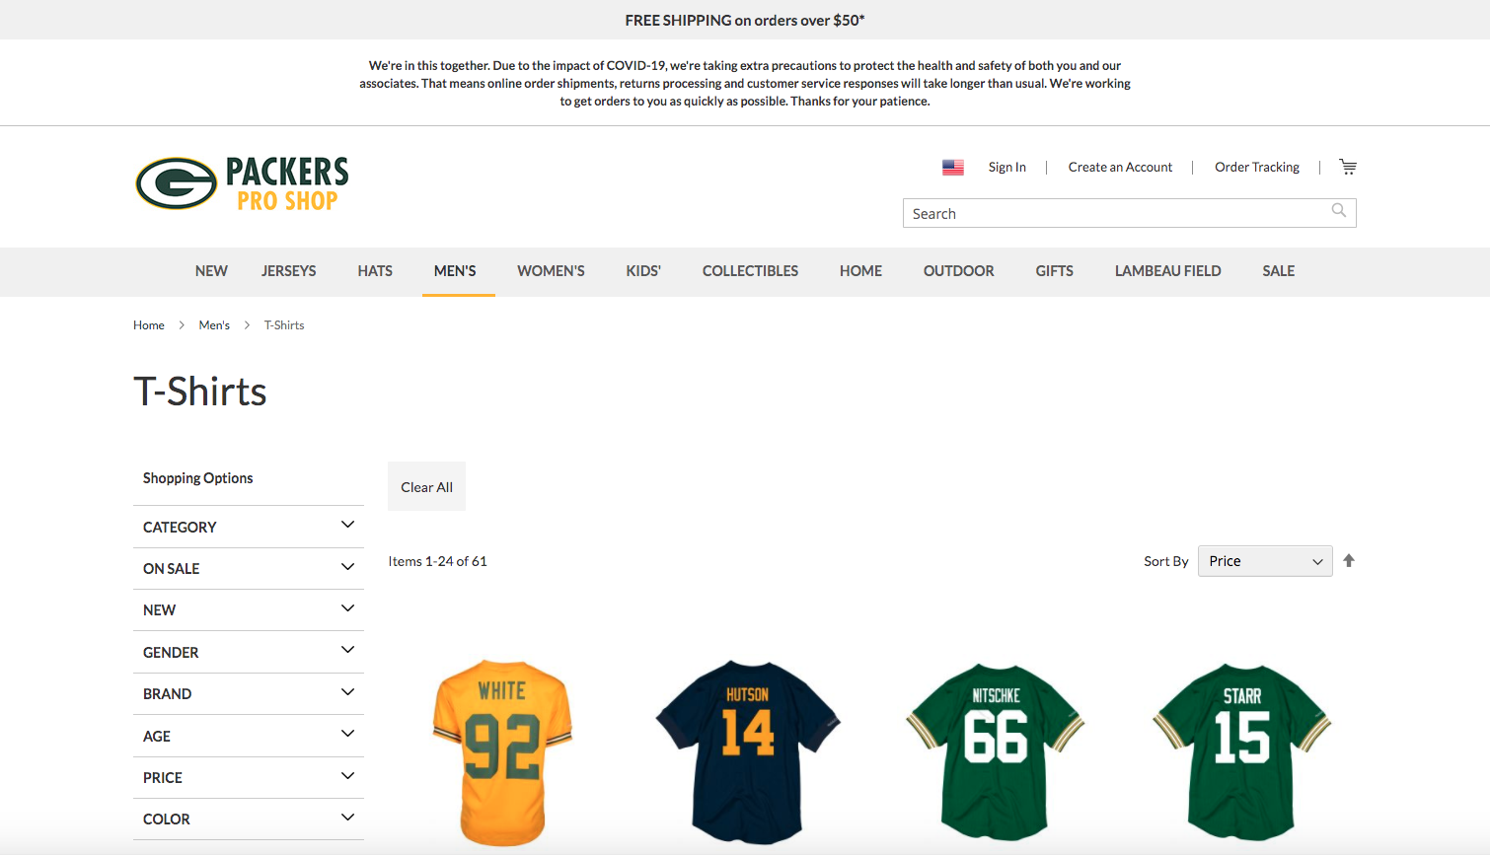
SAMPLE MEN’S T-SHIRTS PCP EXPERIENCES
Overview [B-SORT-2] Sort High to Low Vs Low to High
A – Default “Recommended” Sorting
DEVICES All Device Types
LOCATION PackersProShop.com: Product Category Pages
METRICS Primary: Conversion Rate
Secondary: Revenue per Visitor, Average Order Value, Clicks to Sort By (prop20), Product Views, Cart Additions & Checkouts
AUDIENCES All Visitors to Product Category Pages
REVENUE N/A
B – Pricing > Low to High Sorting Method
C – Pricing > High to Low Sorting Method

Slide 6
2. Design

Slide 7
Design [B-SORT-2] Sort High to Low Vs Low to High
A – Default “Recommended” Sorting

Slide 8
Design [B-SORT-2] Sort High to Low Vs Low to High
B – Pricing > Low to High Sorting Method

Slide 9
Design [B-SORT-2] Sort High to Low Vs Low to High
C – Pricing > High to Low Sorting Method

Slide 10
3. Specifications

Slide 11
Specifications [B-SORT-2] Sort High to Low Vs Low to High
ACTIVITY TYPE A/B
NUMBER OF LOCATIONS https://www.packersproshop.com/green-bay-packers-mens https://www.packersproshop.com/green-bay-packers-womens
(pending scope confirm)
CHALLENGERS Pricing: Low to High Sorting
Pricing: High to Low Sorting
DETAILS
Remove the arrow
Extend dropdown in order to make room for the new text
Filter by price range
Dropdown options should be, sort by:
Recommended
Product Name
Price: High-Low
Price: Low-High
Newest
TARGETING
All Visitors
Segment1: # Per Day (pending scope confirm)
METRICS Primary: Conversion Rate
Secondary: Revenue per Visitor, Average Order Value, Clicks to Sort By (prop20), Product Views, Cart Additions & Checkouts
CONVERSIONS Metric1: # Per Day
Metric2: # Per Day
(pending scope confirm)
TEST DURATION X days to reach significance
(pending scope confirm)

Slide 12
4. Results

Slide 13
Results [X-YY-N] Test Name Here | ##/##/## – ##/##/##
Results Data Graph and/or chart

Slide 14
Results [X-YY-N] Test Name Here | ##/##/## – ##/##/##
[Discovery] | We found that.. |  | X Visitors Metric +$33,747
[Next Step] | We should now do this.. |  | Y Visitors Metric +$5,190
[Next Step] | Implement an enhancement to implementation |  | 4,143,612 Visitors Flat Results No Added Lift
[Recommend] | Test a follow up that does x, y, z |  | Z Visitors Metric +10%
[Recommend] | Consider iterating current design |  | X Visitors Metric +43%

